Slide 1


Slide 2
Product Concept

Slide 3
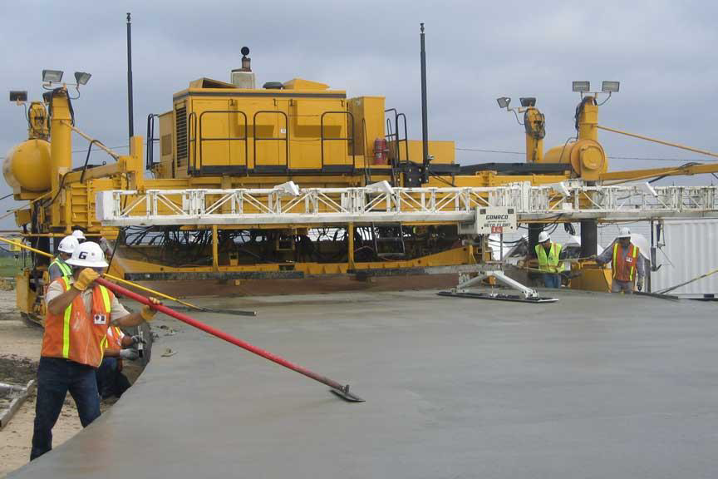
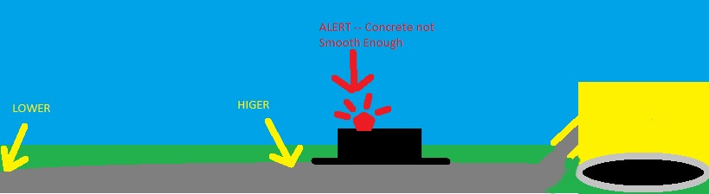
Rear view of a typical paver

Slide 4
Meta Architecture

Slide 5
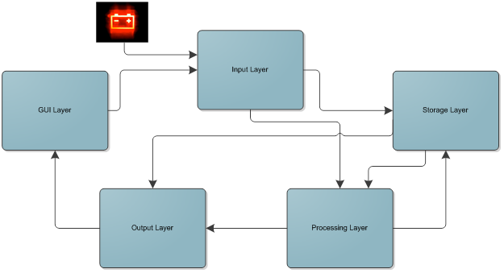

Slide 6
Guiding Principles
Modularity
Easy integration
Staged delivery
Layers and subsystems with clear, well-defined logical roles
Extensibility - Easy to add future items/requirements
Fulfillment of all System Requirement Specifications
Interface with PC only

Slide 7
Assumptions
Varied temperature range/weather
Product will be returned for servicing
Power will come from road paver
Audible bump indicator not necessary

Slide 8
Trade Offs
Output Layer > Output Layer and GUI Layer
Only using PC platform for GUI
File system for removable storage

Slide 9
Layer Descriptions

Slide 10
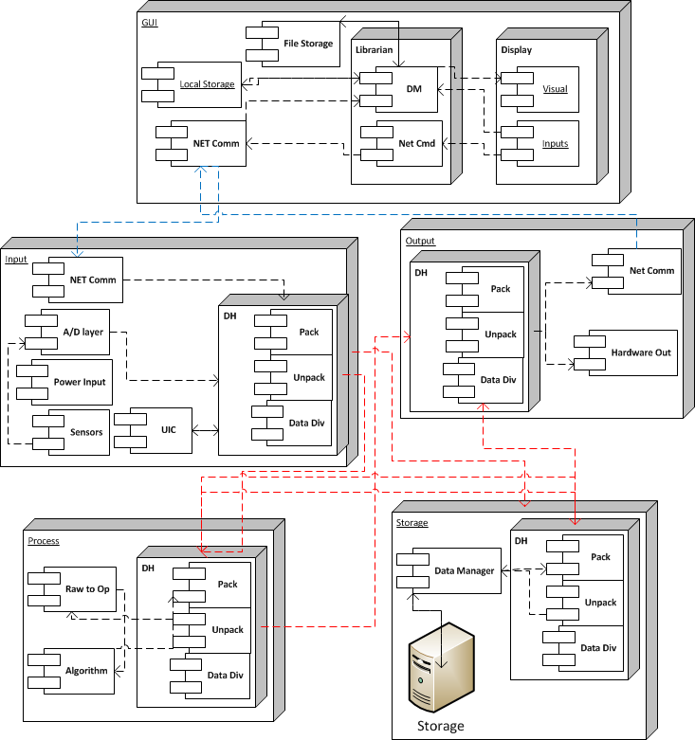

Slide 11
Subsystem Descriptions

Slide 12
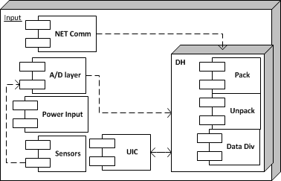
Input Layer

Slide 13
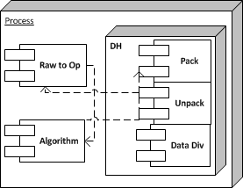
Processing Layer

Slide 14
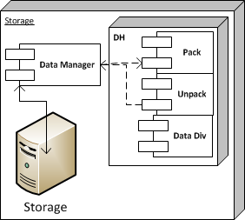
Storage Layer

Slide 15
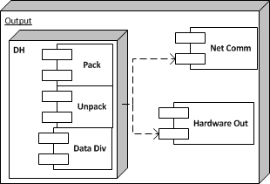
Output Layer

Slide 16
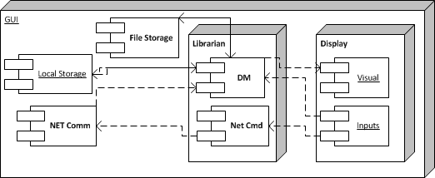
GUI Layer

Slide 17
Data Flows

Slide 19
Use Cases

Slide 20
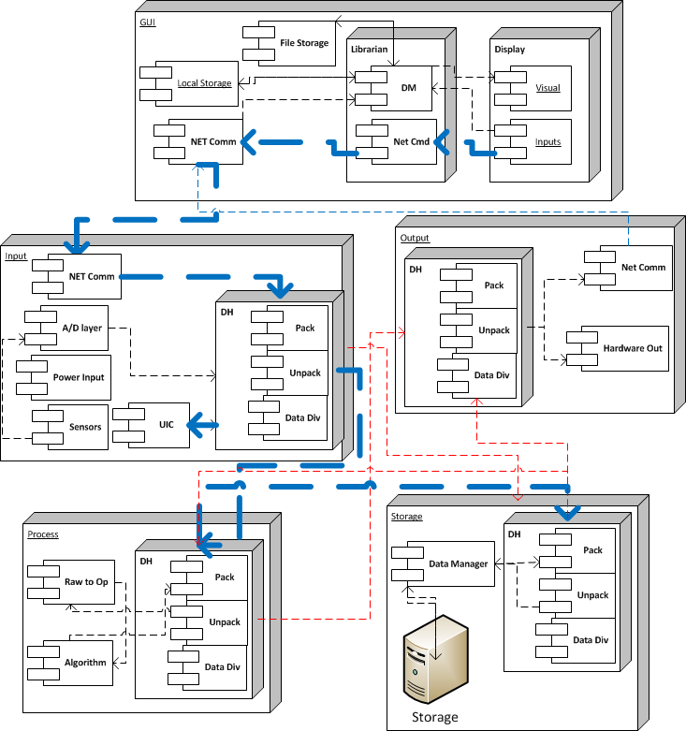
Use Case: Configuration of Product

Slide 21
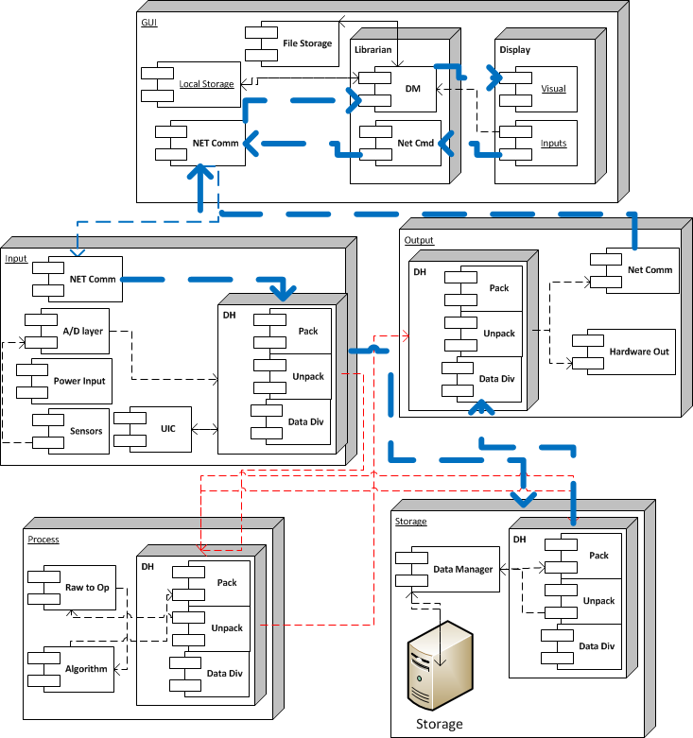
Use Case: Data Retrieval From GUI

Slide 22
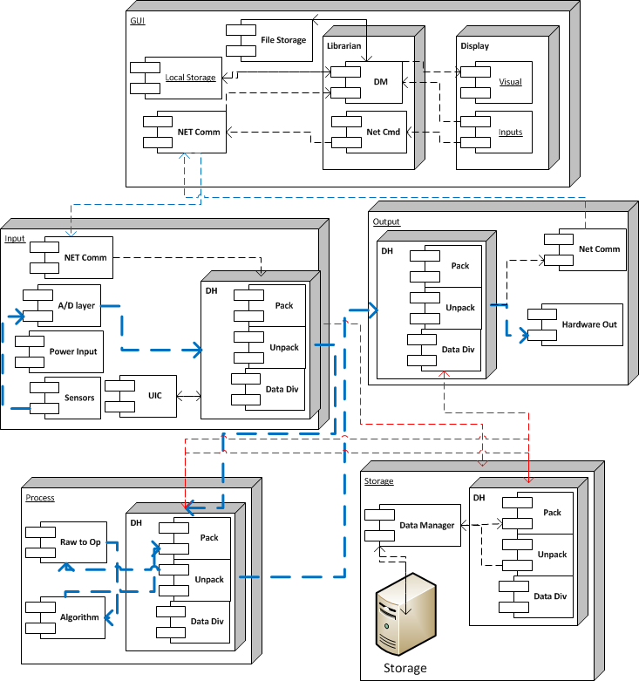
Use Case: Bump Detection

Slide 23
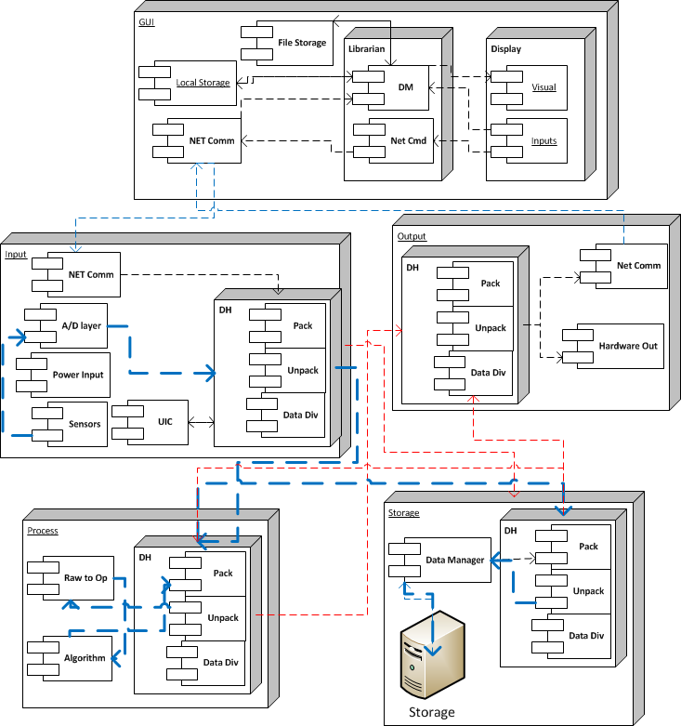
Use Case: Storing Raw/Processed Data

Slide 24
Requirement Mapping

Slide 25
Key Requirements
Number | Requirement | Storage Layer | Process Layer | Input Layer | Output Layer | GUI Layer
3.1 | Power on/off easily |  |  | X
3.3 | Visually indicate error conditions |  |  |  | X
3.4 | Indicate when it is operating normally |  |  |  | X
3.5 | Measure the travel distance of the platform |  |  | X
3.6 | Measure the inclination of the platform from a calibration point |  |  | X
3.7 | Generate operational data from the raw data of the sensors |  | X
3.8 | Transfer operational data to the client application in real-time |  |  |  | X
3.9 | Detect bumps in concrete pavement |  | X
3.13 | Store operational data | X
3.19 | Display operational data |  |  |  |  | X
3.20 | Read stored data | X |  |  |  | X
3.21 | Calibrate sensors |  |  |  |  | X
3.22 | The client application can configure the PIC microcontroller |  |  |  |  | X
3.24 | User-friendly client application |  |  |  |  | X
3.26 | Able to operate in a stand-alone mode | X | X | X | X
3.27 | Visually indicate a bump using a beacon light |  |  |  | X

Slide 26
OS Dependencies
GUI Layer
Developed in Java with a Windows PC
Java Development Kit
customer will require a machine with compatible Java Runtime Environment installed
Required system components will be provided by the JRE (ie. network stack)
Other Layers
Developed in C with a Windows PC
MPLab C development environment

Slide 27
Testing Considerations

Slide 28
Layer Testing
Sub-system testing
Layer testing
Inter-layer testing

Slide 29
Layer Testing Example
Input Layer Testing:
The Input Layer will be tested to make sure that it accepts sensor inputs and user inputs and correctly sends the data to the Storage Layer and Processing Layer.

Slide 30
Integration Testing
Use Cases
Backward Chaining
Forward Chaining
Requirement Mapping
Proper system data flows
Design validation

Slide 31
Questions?

